Slide 1


PROJECT ON
EMPLOYEE MANAGEMENT
ANALYSIS
PRESENTED BY:
NAME : Y.JYOTHI
BATCH : 456

Slide 2

ABOUT ME
My Name is JYOTHI YADAVALLI.
I have completed my Masters Degree in BIOINFORMATICS
Linked In : https://www.linkedin.com/in/jyothi-yadavalli-202a4a315

Slide 3
AGENDA
•BUSINESS PROBLEM AND PROBLEM STATEMENT
•BUSINESS OBJECTIVE
•INTRODUCTION
•ER DIAGRAM AND RELATIONSHIP
•EMPLOYEE INSIGHTS
•QUALIFICATION AND SKILLS ANALYSIS
•JOB ROLE AND DEPARTMENT ANALYSIS
•LEAVE AND ABSENCE PATTERNS
• PAYROLL AND COMPENSATION ANALYSIS

Slide 4



BUSINESS PROBLEM
Organizations struggle to manage employee data effectively when information is stored in unstructured or disconnected systems.
This makes it difficult to track payroll expenses, analyze leave patterns, monitor salary distribution, and ensure data consistency for informed HR decision-making.
PROBLEM STATEMENT
To overcome these issue, a structured relational database was developed using SQL to manage employee, department, salary, leave, and payroll data. The system enables analysis of key HR metrics and supports data-driven workforce and payroll management.

Slide 5




INTRODUCTION
This project focuses on designing and analyzing an Employee Management System using SQL to efficiently manage organizational data related to employees, departments, salaries, qualifications, leaves, and payroll.
A structured relational database was developed with multiple interconnected tables linked through primary and foreign keys to ensure data integrity and consistency.
SQL queries were executed to analyze key workforce metrics such as total employees, department-wise salary distribution, payroll expenditure, leave patterns, and compensation trends.
The project aims to generate meaningful HR insights and support data-driven workforce planning and payroll management.

Slide 6
OBJECTIVE
The main goals of this SQL project are:
To design and implement a relational database for managing employee records.
To establish relationships between multiple tables using primary and foreign keys.
To maintain referential integrity using constraints such as CASCADE and SET NULL.
To retrieve and manipulate employee data using SQL queries.
To perform workforce analytics such as salary distribution, leave trends, and payroll analysis.
To practice advanced SQL concepts including joins, aggregations, filtering, and sorting.

Slide 7
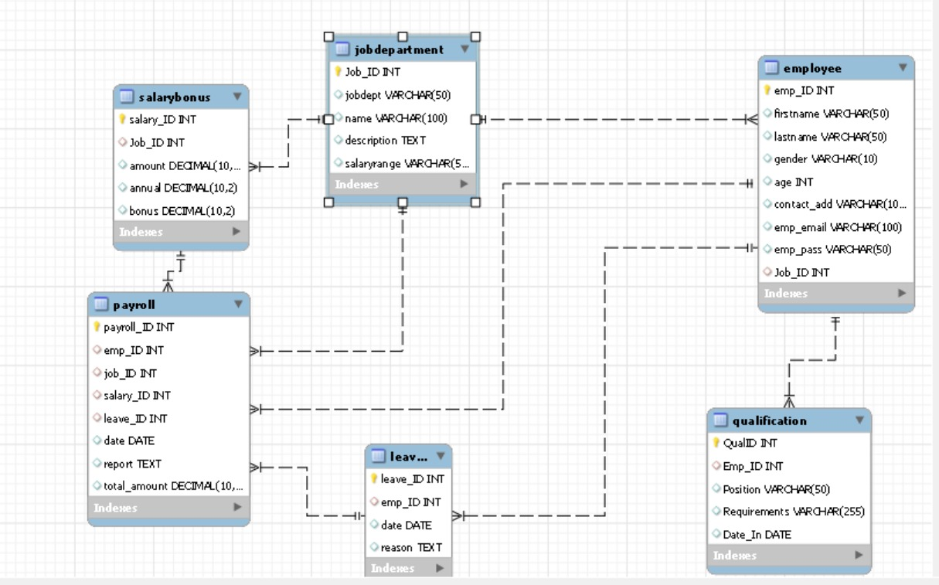
ER DIAGRAM

Slide 8
RELATIONSHIP BETWEEN THE
TABLES
One-to-Many from JobDepartment to Employee
One-to-Many from JobDepartment to SalaryBonus
One-to-Many from Employee to Qualification
One-to-Many from Employee to Leaves
One-to-Many from Employee to Payroll
One-to-Many from SalaryBonus to Payroll
One-to-Many from JobDepartment to Payroll
One-to-Many from Leaves to Payroll

Slide 9
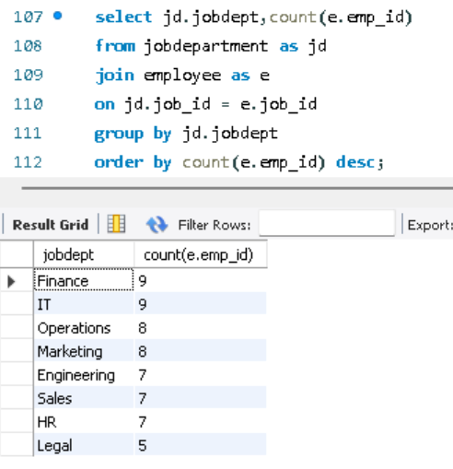
CUSTOMER INSIGHTS
Which departments have the highest number of employees?

Slide 10
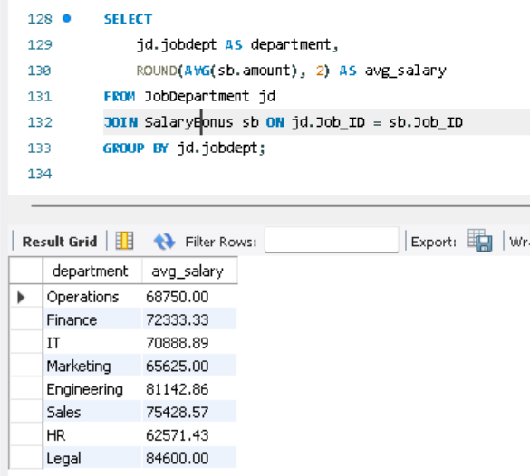
What is the average salary per department?

Slide 11
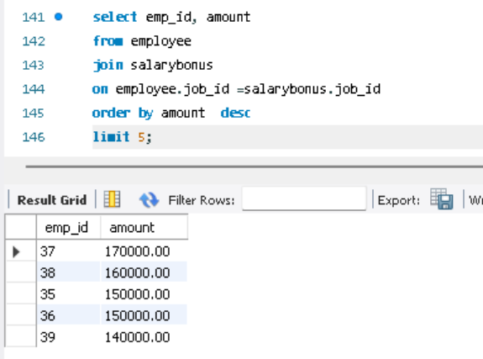
Who are the top 5 highest-paid employees?

Slide 12
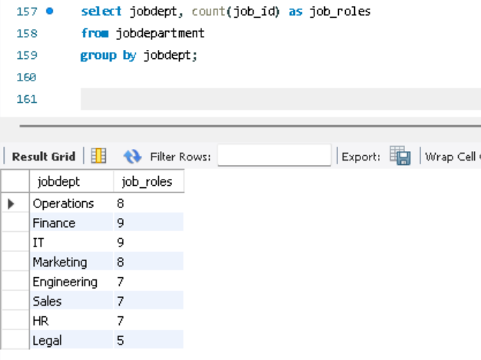
JOB ROLE AND DEPARTMENT ANALYSIS
How many different job roles exist in each department?

Slide 13
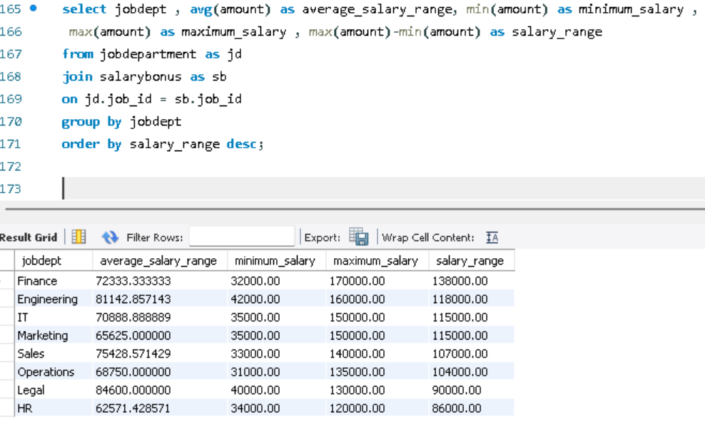
What is the average salary range per department?

Slide 14
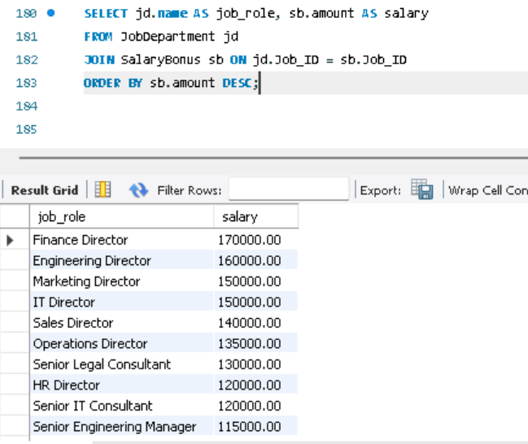
Which job roles offer the highest salary?

Slide 15
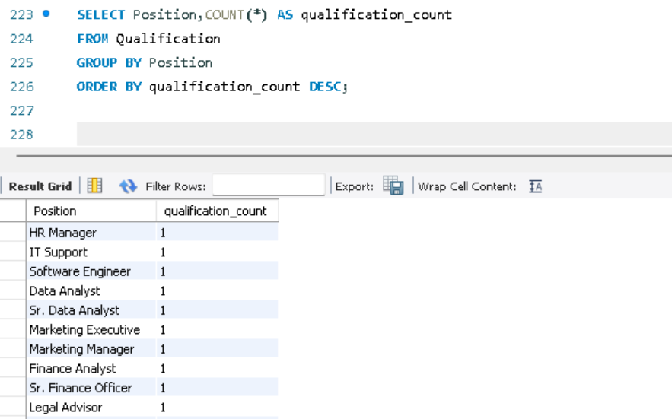
QUALIFICATION AND SKILLS ANALYSIS
Which positions require the most qualifications?

Slide 16
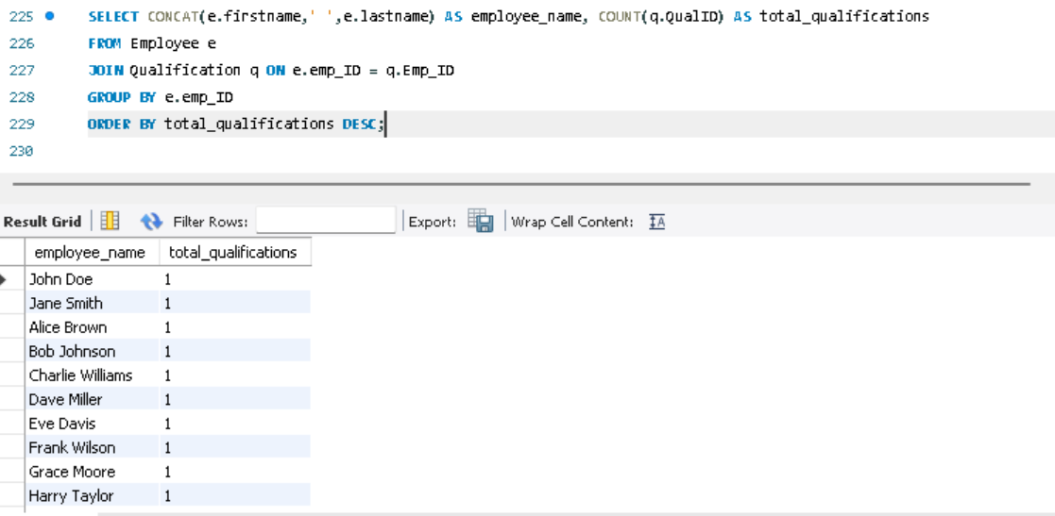
Which employees have the highest number of qualifications?

Slide 17
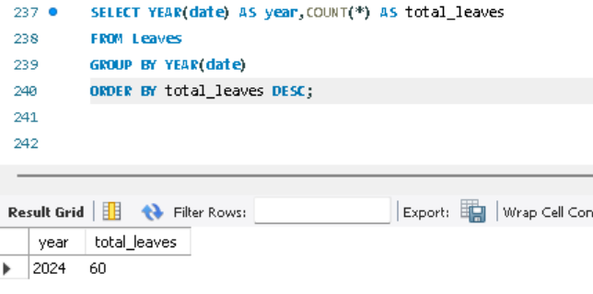
LEAVE AND ABSENCE PATTERNS
Which year had the most employees taking leaves?

Slide 18
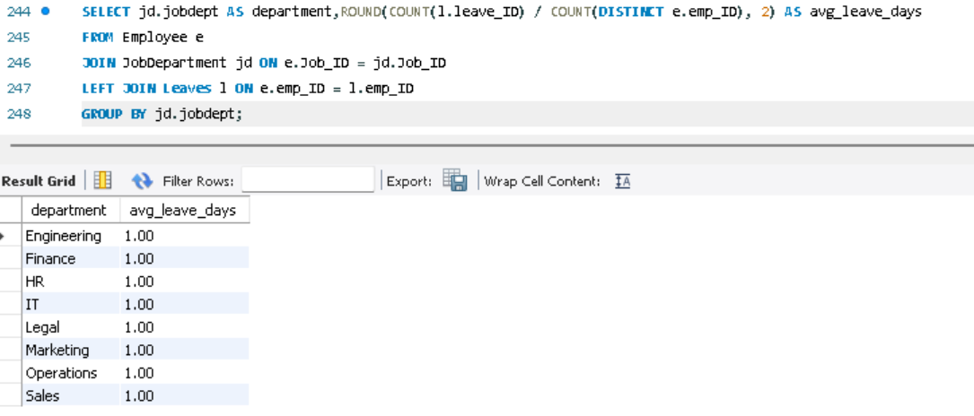
What is the average number of leave days taken by its employees per department?

Slide 19
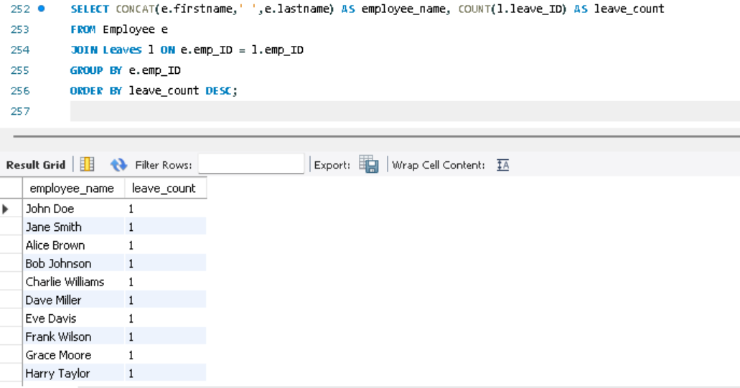
Which employees have taken the most leaves?

Slide 20
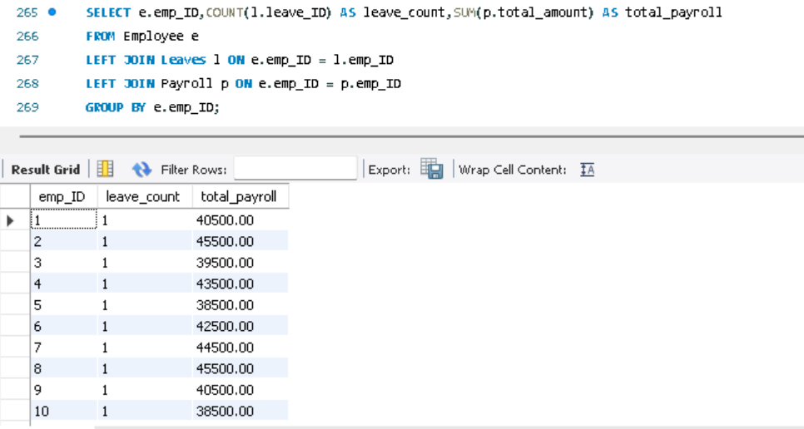
How do leave days correlate with payroll amounts?

Slide 21
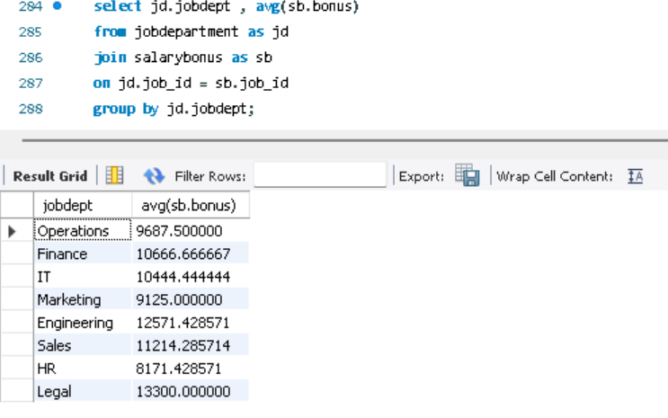
PAYROLL AND COMPENSATION ANALYSIS
What is the average bonus given per department?

Slide 22
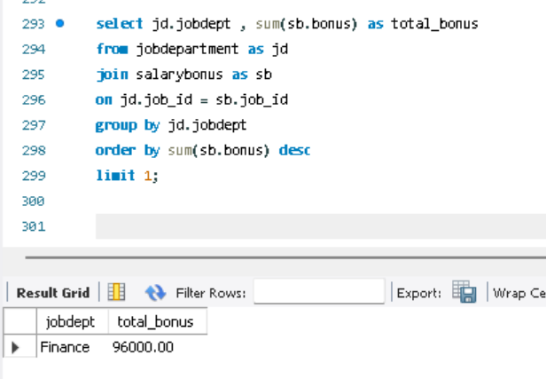
Which department receives the highest total bonuses?

Slide 23
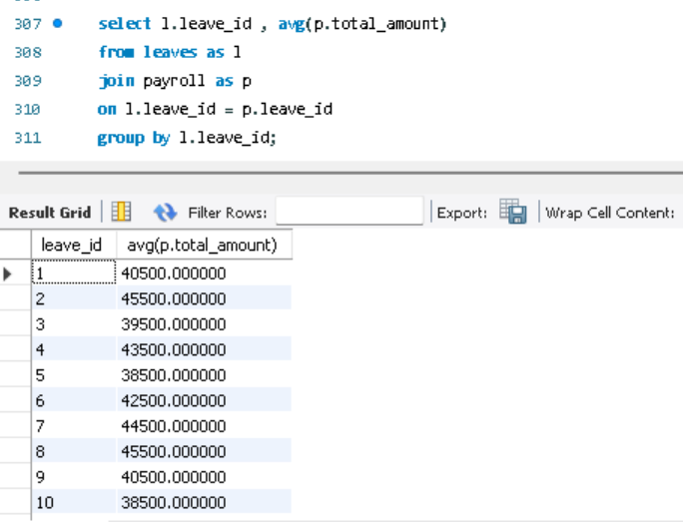
What is the average value of total_amount after considering leave deductions?

Slide 24
FINAL INSIGHTS
The SQL database created a centralized system to manage employee, salary, leave, and payroll data accurately.
Department analysis showed differences in employee count and salary distribution across various roles.
Payroll analysis helped understand total company salary expenses and identify the highest-paid roles.
Leave analysis showed how employee absences affect payroll calculations and overall costs.
Qualification analysis gave insight into employee skills and identified roles that require higher expertise.

Slide 25
RECOMMENDATIONS
Implement a centralized SQL system to manage employee data in a structured and organized manner.
Utilize SQL queries and table relationships to extract meaningful workforce insights.
Regularly review payroll and leave data to improve cost management and workforce planning.
Generate automated employee reports to support quicker and more informed decisions.
Maintain strong data consistency by designing the database with proper keys and constraints.

Slide 26
CONCLUSION
The Employee Management System successfully demonstrates the design and implementation of a structured relational database using SQL to manage workforce data efficiently.
By integrating employee, department, salary, leave, and payroll information into a centralized system, the project ensures data consistency, integrity, and analytical clarity.
Through SQL-driven analysis, meaningful workforce and compensation insights were generated, supporting informed HR decisions and strategic payroll management.
Overall, the project highlights the practical application of SQL in solving real-world organizational challenges and enabling data-driven workforce planning.

Slide 27

Q&A

Slide 28

THANK YOU!

